Slide 1
Lecture 11:
Environmental Rights and
Justice - II
Course: Environment and Politics in India

Slide 2
Citizenship and the Environment

Slide 3
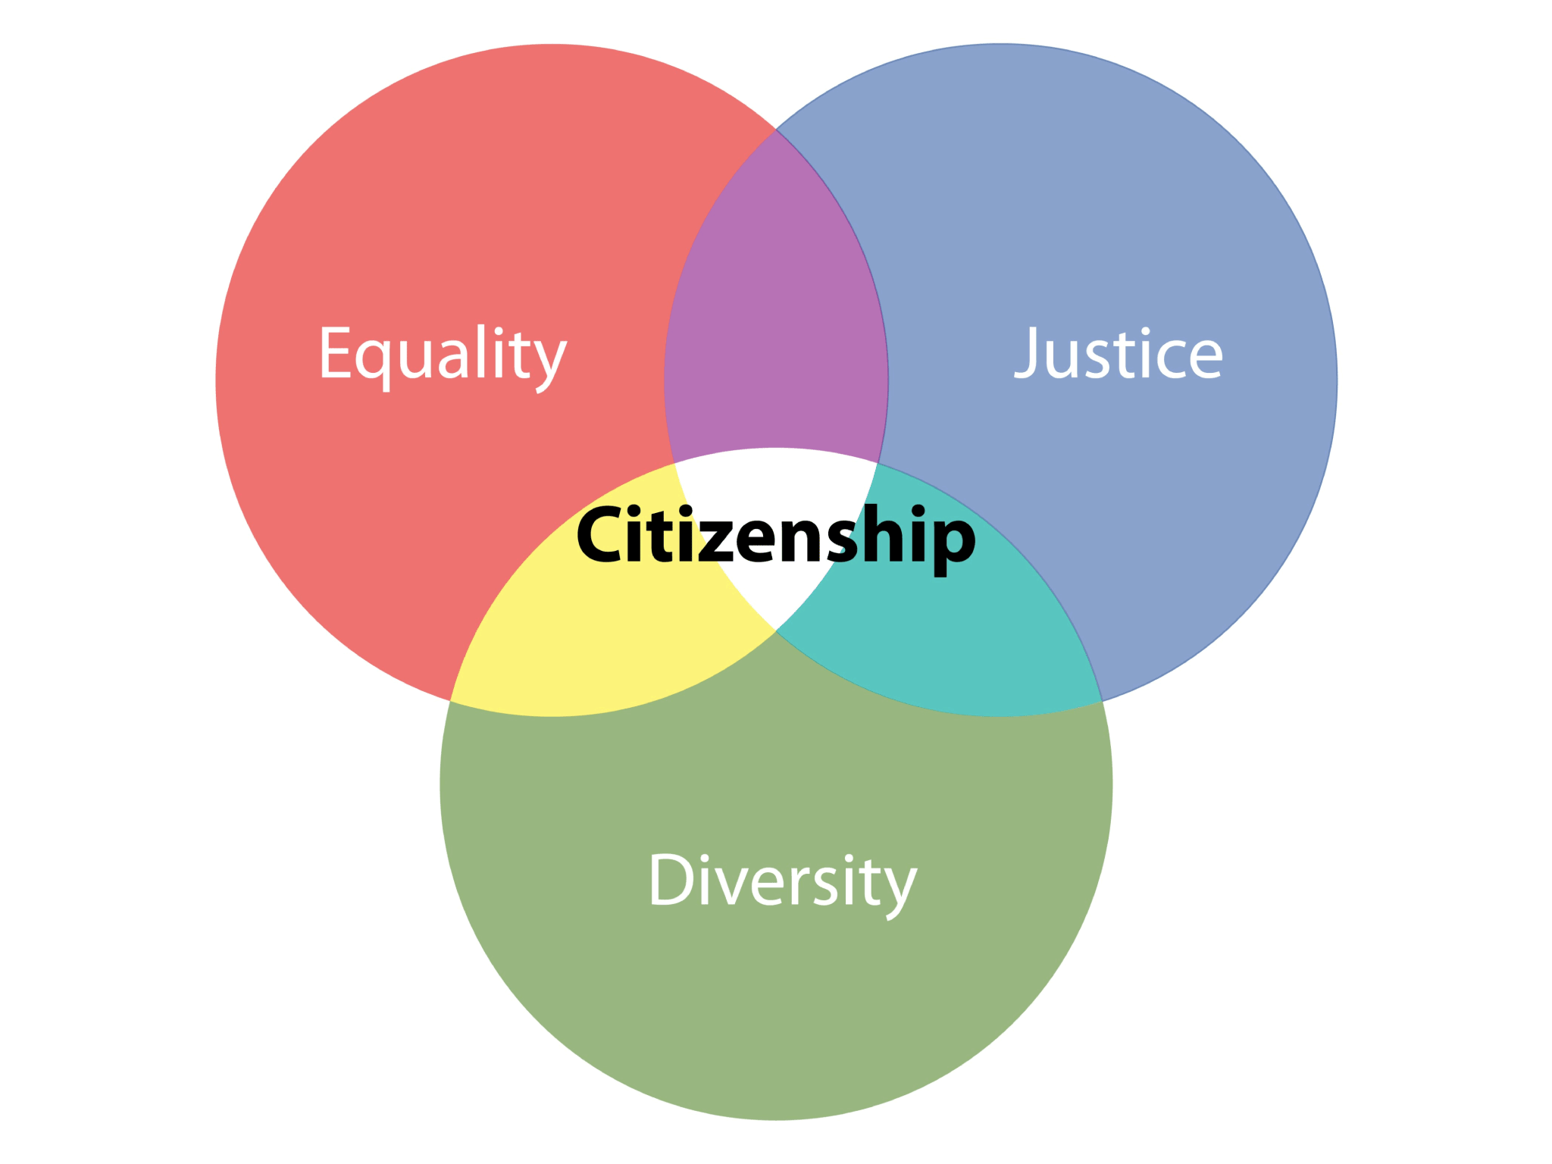
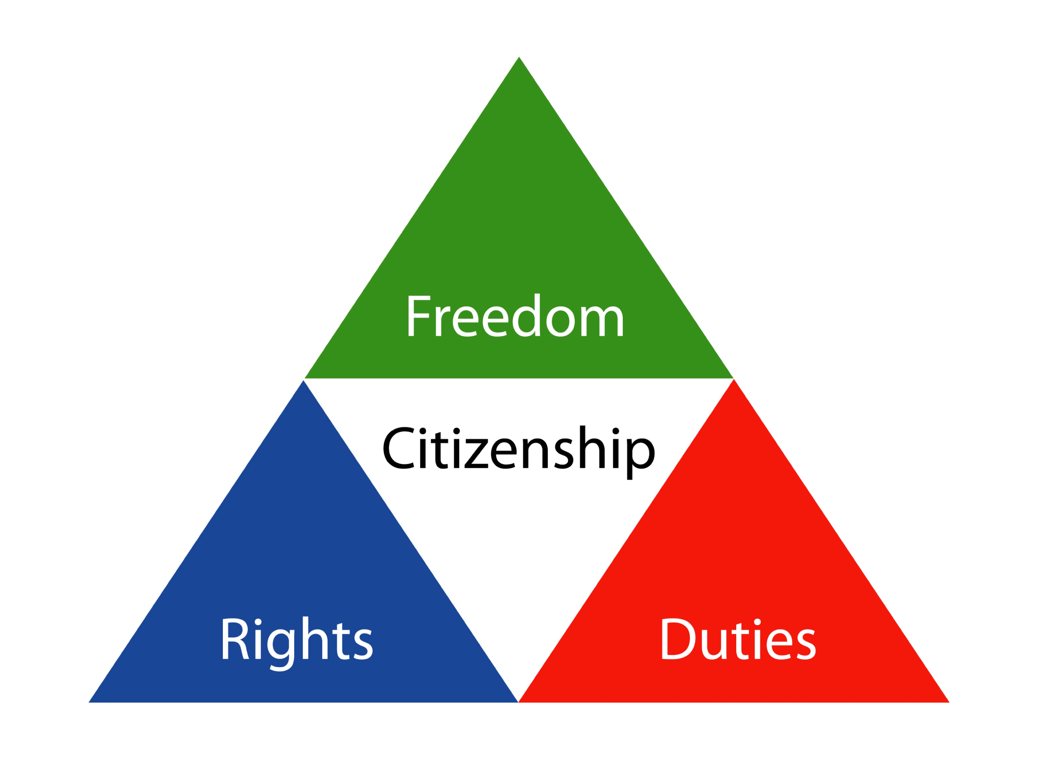
Citizenship

Slide 4
Citizenship
  Moving beyond the LEGAL-FORMAL framework (Rights, Duties, Entitlements, Claims...) to understand citizenship
  CRUCIAL elements of Citizenship: Equality and Integration.
  Benefits should become UNIVERSAL and EGALITARIAN.
  Questions:
  WHO are ‘citizens’? WHO are excluded?
  What is the process of INCLUSION/EXCLUSION?
  What is the NATURE of citizenship? Legal? Participation in decision-making?
  How does a citizen PARTICIPATE?
  Relationship between INDIVIDUALS and the larger political/cultural COMMUNITY?
  What are the RIGHTS and RESPONSIBILITIES of a citizen?

Slide 5
Historical Development of ‘Citizenship’
  CONCEPTS:
  CIVIC REPUBLICANISM (‘Common good’, ‘Public spirit’, ‘Political Participation’). Explicitly PUBLIC and POLITICAL.
  LIBERAL INDIVIDUALISM. Passive citizenship (Liberty, Individual Rights, Private Interests)
19th century:
Tensions between CIVIC REPUBLICANISM and LIBERAL INDIVIDUALISM.
Emergence of citizens as individuals with PRIVATE and CONFLICTING interests (rather than common interests).
Individual rights, individual mobility, tensions over mobility.
Emergence of an all-encompassing ‘national political community’.

Slide 6
Historical Development of ‘Citizenship’
T.H. Marshall’s idea UNIVERSAL citizenship:
Civil Rights: Individual freedom (speech/movement/property), freedom to own property, equality before the law
Political Rights: Right to vote/hold public office/stand for office.
Social Rights: Right to a basic minimum social status (good/housing/education).
REMOVING inequalities of ETHNICITY/CLASS/CASTE/GENDER.
ENSURING integration.

Slide 7
Environmental ‘Citizenship’
WHO is an environmental citizen?
Environmentally informed and aware
Having environmental concern
Exhibiting environmentally responsible behaviour
Key ‘value‘ underpinning environmental citizenship?
Justice between humans. NOT concern for the environment for its own sake.
Rights (to a livable ecological space) and responsibilities (to reduce ‘ecological footprint’),
Involves BOTH private and public action.

Slide 8
Environmental ‘Citizenship’
MAIN characteristics of the environmental citizen:
Believes that environmental sustainability is a common good that will not be achieved by the pursuit of individual self-interest alone
Along with self-interest, is moved by other motivations
Believes that ethical and moral knowledge is as important as techno-scientific knowledge
Believes that other people’s environmental rights engender environmental responsibilities
Believes that these responsibilities are due not only to one’s neighbours or fellow-nationals but also to distant strangers (distant in space and even in time)
Has an awareness that private environment-related actions can have public environment-related impacts

Slide 9
Environmental ‘Citizenship’
MAJOR ideas:
Finite and Diminishing environmental resource.
Common good: Notion of a commonly owned/managed space necessary for survival.
Environment as a common-pool resource available to ALL.
Need to reduce DISTANCE between ‘US’ and CONSEQUENCES of our actions. Will not happen NATURALLY, has to be ACTIVELY put in place through strategies and practices.
“…MORAL and POLITICAL rights and responsibilities of agents in a democratic community, defined in terms of their obligations to other humans”
COMBINATION of CIVIC REPUBLICANISM and COSMOPOLITANISM

Slide 10
Environmental ‘Citizenship’
Cosmopolitanism
Multiracial/non-homogenous
Feeling ‘at home’ in a number of countries
‘Citizen of the cosmos’/Universe
Relationship between cosmopolitanism and environmental citizenship?
  Environmental problems have NO ‘national’ boundaries
  Environmental citizenship requires care for PUBLIC LIFE, and a comfort level/empathy with the ‘OTHER’

Slide 11
Environmental ‘Citizenship’
TRADITIONAL citizenship versus ENVIRONMENTAL citizenship:
Traditional citizenship: RECIPROCAL relationship between rights and duties. Lack of responsibility -> Curtailing of rights.
VERTICAL relationship between citizens and the STATE.
Environmental citizenship: Less clear-cut relationship. HORIZONTAL relationship between fellow-citizens.
Relationship between rights and duties: LESS about the rights and duties of citizens vis-à-vis the government, MORE about the rights and duties of citizens vis-à-vis each other.

